Slide 1
Honey Bee
Final Project
蔡承潤 Ryan Tsai
陳佩琪 Izzy
蔣誘河 Yuha Jang

Slide 2
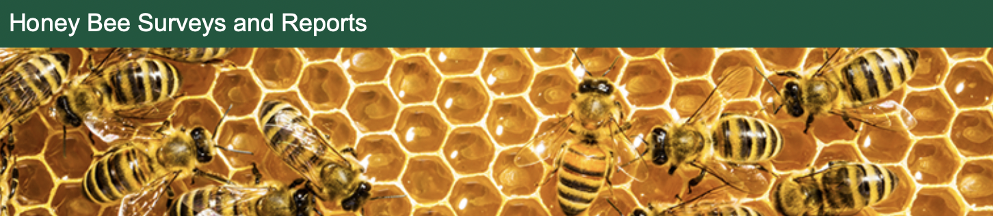
Overview
In recent years, there has been a significant decline in honey bee population due to Colony Collapse Disorder and other stressors. At the same time, the United States’ honey industry has been affected. There have been many efforts to monitor honey bee populations and honey production, including an annual survey by the United States National Agricultural Statistics Service. However, the data is not presented in an engaging manner, so it is difficult to understand the issue of declining honey bee populations and how this affects honey production. We propose building a visualization to allow environmentalists, government officials and the general public to visually explore a dataset of honey bee colonies and honey production over time. Our visualization will show population changes in honey bee colonies and honey production, allowing users to explore this data by state and filtering on different variables including state and year.

Slide 3
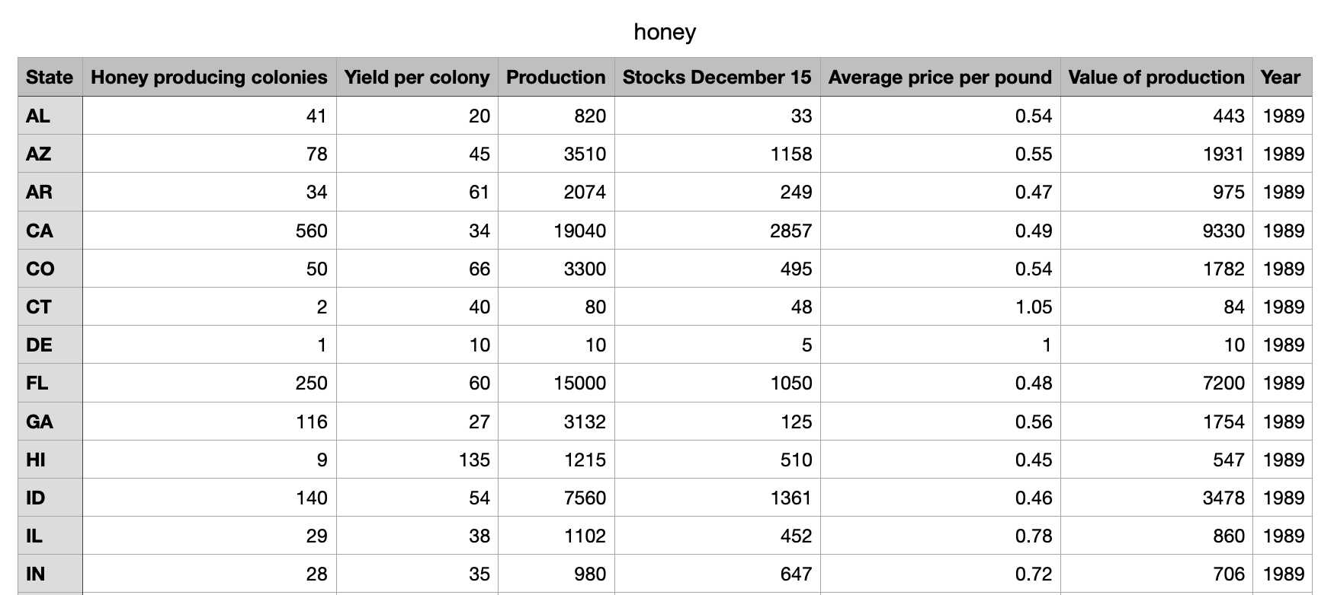
Dataset
The annual report of the number of colonies producing honey, yield per colony, honey production, average price, price by color class and value; honey stocks by state and U.S.
https://usda.library.cornell.edu/concern/publications/hd76s004z?locale=en

Slide 4
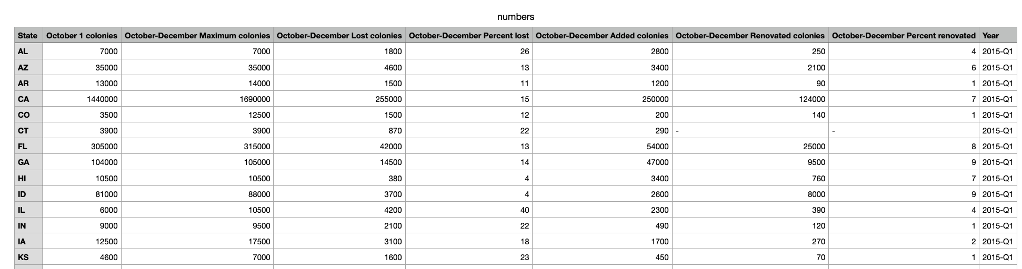
Dataset
The number of colonies, maximum, lost, percent lost, added, renovated, and percent renovated, as well as colonies lost with Colony Collapse Disorder symptoms with both over and less than five colonies
https://usda.library.cornell.edu/concern/publications/rn301137d?locale=en

Slide 5
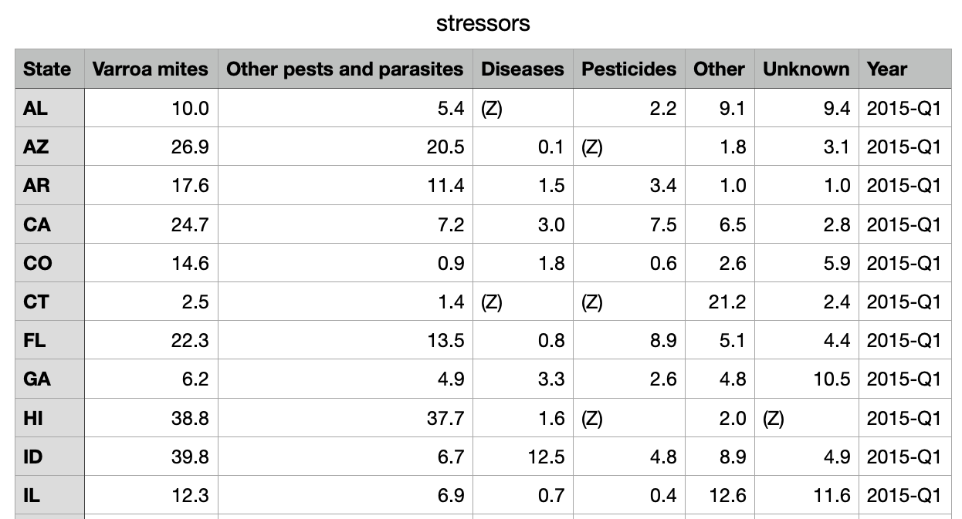
Dataset
The colony health stressors with five or more colonies. For example, varroa mites, other pests and parasites, diseases, pesticides, etc.
https://usda.library.cornell.edu/concern/publications/rn301137d?locale=en

Slide 6
Usage Scenario and Tasks
-The environmentalist : Mia is an environmentalist in the USA. Due to environmental pollution, bee colonies are decreasing. Accordingly, honey production is also on the decline. Furthermore, honeybees are very vulnerable to colony stressors. She can get data from our project on the amount of colony loss, rate of decline, and so on for honeybees in each state in the United States. In addition, it is easy to find out which state has the largest colony loss due to stress sources through visual data. Naturally, the average price, production, and inventory of honey are inevitably reduced because the honey production, or supply, is reduced. Data for each state of the United States can be obtained from our project. This data can be used to urge each governor of the United States to establish environmental policies. Data accumulated every year for several years can be used to statistically quantify colony loss and persuade people to avoid economic and natural damage caused by this environmental pollution.
-National Geographic Director : Erin serves as the director of National Geographic. Her team wants to make a special documentary about honey bee colonies this season. It is effective to film documentaries where the changes are most noticeable. So we're going to look at the states that have had the most bee colony decline in years and go to the area and film them. It is possible to show the current situation of honeybee ecology realistically by capturing the process of bees creating honey on camera, capturing the appearance of bees dying due to environmental pollution or stress from urban development, and capturing the remarkably visible decrease in camera.

Slide 7
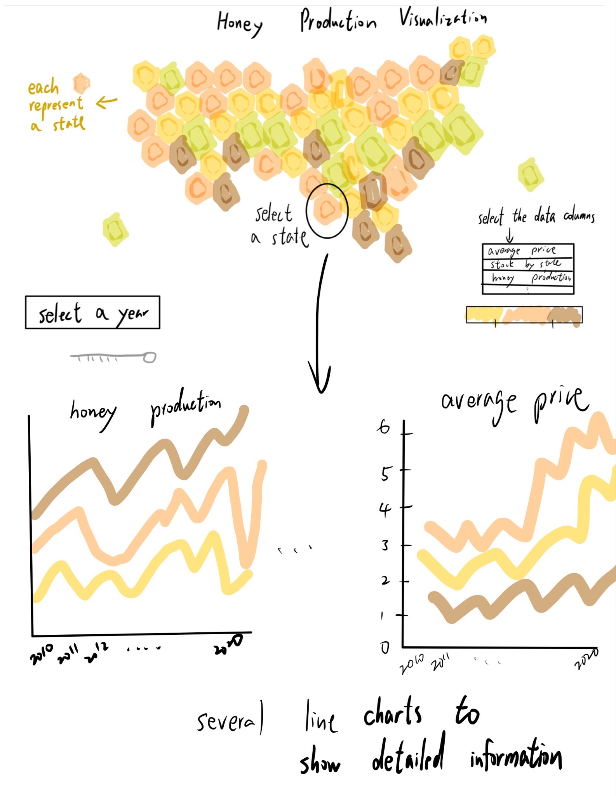
What we’ve done for the project
Data processing: The data is separated into multiple files by year, so the data will need to be combined into one file, and irrelevant rows removed.
Visualization Sketch: Because these dataset are based on the USA, specially, each state of the USA. That’s the reason why we use the map to represent each data and graphs along with the region.
Visual Design: we used javascript to make the visualization works under the web-based environment. Our visualization is interactive with map and line graphs. we can look the whole view through the map and recognize the details through the line graphs.
Storytelling: expect that who can use this data and visualization in the future. expect that this data and visualization would be helpful to whom.
Overview: check that all of the functions works well, and whether we can get the result that we want or not.

Slide 8
Demonstration

Slide 10
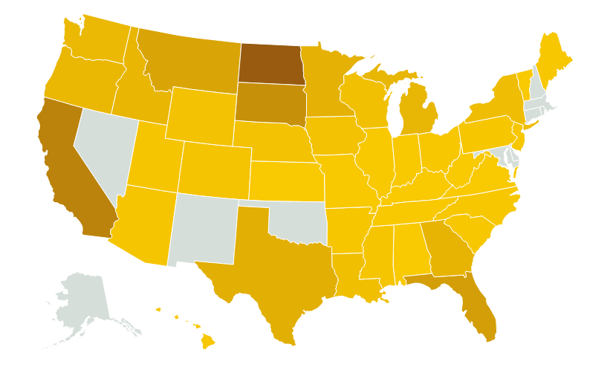

Slide 11
Explanation _ Honey Production Map
If you drag the point on the top left of the page. We can select an exact year. Then, we can move the cursor to the map. If you put the cursor on the top of an exact state, for example, Arizona, then you can know the honey production amount by honey bees at that year you selected. Like this, you can know the honey production of each state of each year.
It’s useful when someone wants to compare the difference of honey production amount between several states. Because it is a formation of map, so we can recognize the location, too. We also used color to represent the amount of honey production, the deeper the more. So, it’s easy to compare at a glance, visually.

Slide 13
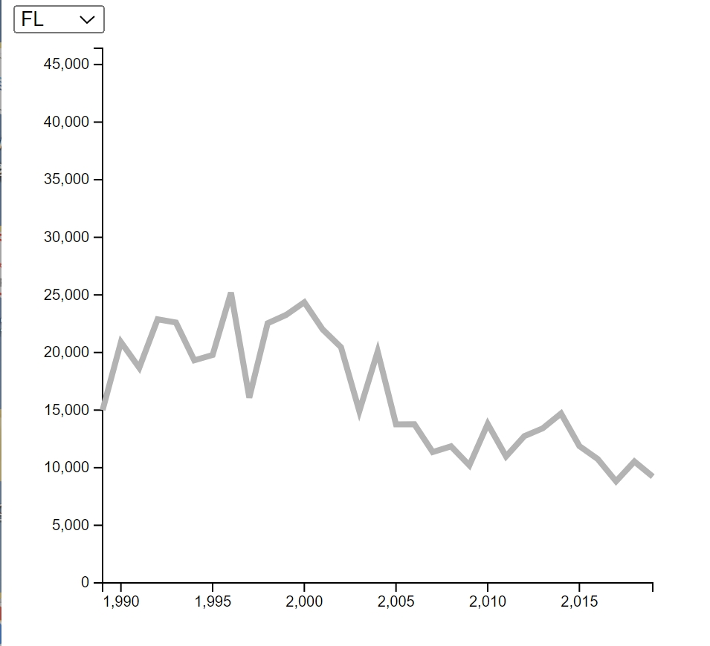
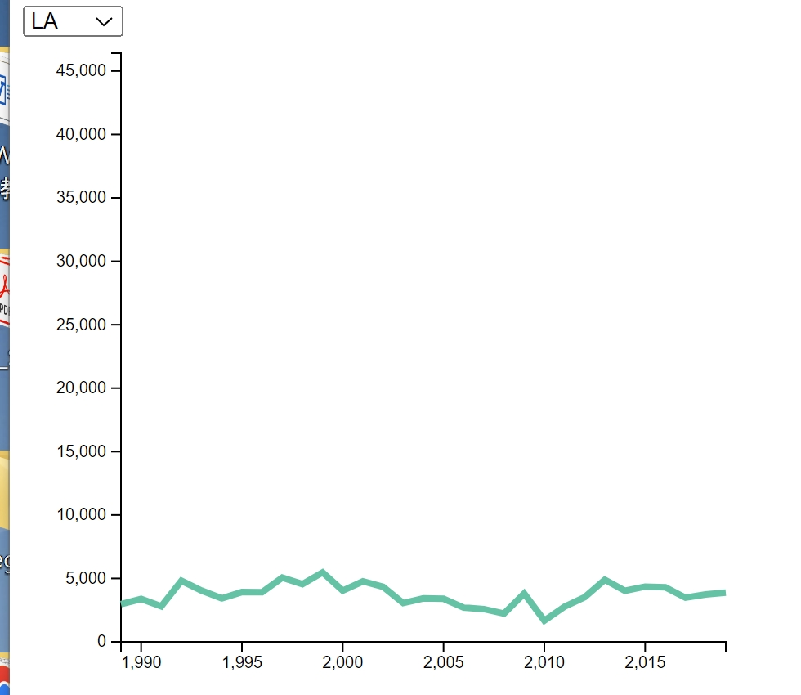

Slide 14
Explanation _ Line Graphs
We offer several line graphs, which represent specific subject, respectively.
If you choose a specific state of the U.S.A on the top left, then a coordinate function graph will appear. The x-axis represents the year. Therefore, it is easy to understand the change of the y-axis data over time.
If someone wants to compare honey production in each region in a specific year, it would be better to use a map, but if someone wants to compare honey production by year in a specific region, whether the change has occurred rapidly, has decreased or increased over time? If you want to know that, it would be better to use the line graph.

Slide 15
Thank you.

